Slide 1
Module-5:
GUI PROGRAMMING AND APPLETS

Slide 2
Module-5: GUI PROGRAMMING AND APPLETS (6)
GUI Programming with Java: The AWT class hierarchy, introduction to swing, swings Vs AWT, hierarchy for swing components.
Containers: JFrame. JApplet, JDialog. Jpanel,
Overview of some swing components: JButton, JLabel, JTextField, JTextArea, simple applications.
Layout management: Layout manager types, border, grid and flow.
Applets: Inheritance hierarchy for applets, differences between applets and applications, life cycle of an applet, passing parameters to applets.

Slide 3
What is GUI?

Slide 4
AWT and Swing

Slide 5
AWT class:
The AWT (Abstract Window Toolkit) is a key part of Java's original graphical user interface (GUI) framework. It provides a set of classes for building user interfaces (UI) like windows, buttons, text fields, and menus.
Java AWT (Abstract Window Toolkit) is an API to develop Graphical User Interface (GUI) or windows-based applications in Java.
The java.awt package provides classes for AWT API such as TextField, Label, TextArea, RadioButton, CheckBox, Choice, List etc.

Slide 6
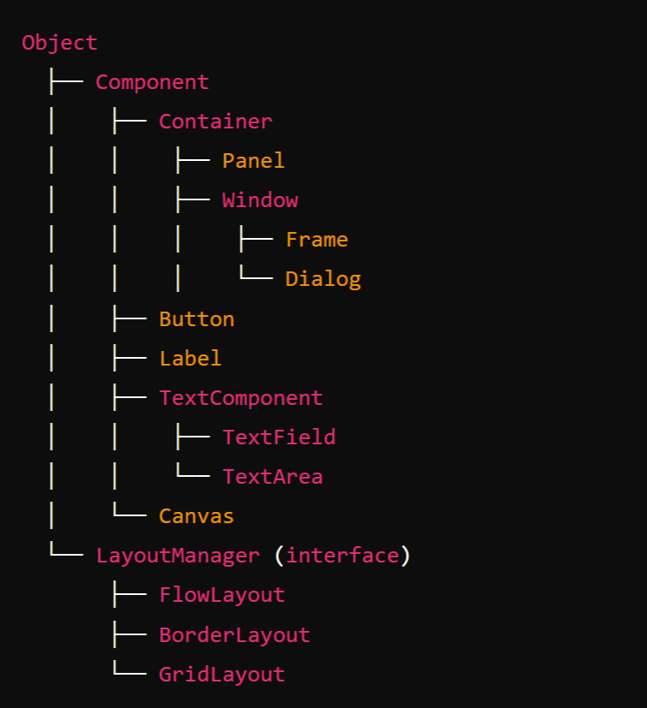
AWT Class Hierarchy
1. Object
The root of the class hierarchy in Java. All classes inherit from Object, including those in AWT.
2. Component (extends Object)
The base class for all AWT components. It represents the common attributes and behaviors of UI elements, such as buttons, labels, text fields, etc.
Key subclasses of Component:
Container: Can contain other components.
Button: Represents a clickable button.
Label: Displays a text string.
TextComponent: Base class for TextField and TextArea.
Scrollbar: Adds a scrollbar to a component.
Canvas: Provides a blank area on which custom drawing can be done.

Slide 7
3. Container (extends Component):
A specialized component that can hold other components (like panels, frames).
Subclasses of Container:
Window: Represents a top-level window with no borders or menus (typically used for creating dialogs or windows).
Subclasses of Windows:
Dialog: A pop-up window often used to interact with the user.
Frame: A fully functional window with title, borders, and buttons like minimize, maximize, and close.
2. Panel (extends Container):
A generic container used for grouping other components.
A container for organizing components in a specific layout. Frequently used for grouping elements.

Slide 8
4. TextComponent (extends Component):
The base class for text-related components.
Subclasses:
TextField: A single-line text input field.
TextArea: A multi-line text input area.
5. LayoutManager
An interface used to define how components are arranged in a container.
Key implementations:
FlowLayout: Lays out components in a row.
BorderLayout: Arranges components in five areas (North, South, East, West, and Center).
GridLayout: Arranges components in a grid of rows and columns.

Slide 9
Swing:
Swing is a part of Java's JFC (Java Foundation Classes) and is a more advanced and flexible GUI toolkit compared to AWT (Abstract Window Toolkit).
While AWT provides basic components and is platform-dependent (uses native GUI components), Swing is built on top of AWT and is platform-independent because it renders its components using Java code rather than relying on the underlying operating system's native components. This allows for a more consistent look and feel across different platforms.

Slide 10
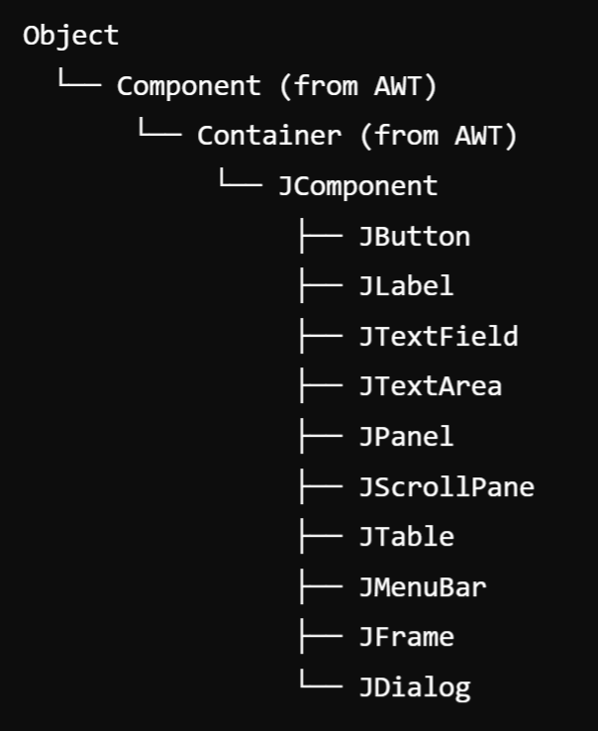
Hierarchy for Swing components:
The Swing component hierarchy in Java follows a well-defined structure based on the AWT hierarchy but adds its own set of components for creating rich user interfaces.
1. Object
The root class of all Java classes.
2. Component (from AWT)
The base class for all graphical components that can be added to a GUI.
3. Container (from AWT)
A subclass of Component that can hold other components (like panels or frames).
4. JComponent (extends Container)
The base class for all Swing components. It provides additional functionality such as double buffering, borders, and tooltips.

Slide 11
Core Swing Components (Subclasses of JComponent):
Component | Description
JButton | Represents a clickable button.
JLabel | Displays static text or an image.
JTextField | A single-line text input field.
JTextArea | A multi-line text area for text input or output.
JPanel | A generic lightweight container used for organizing components.
JScrollPane | Provides a scrollable view of another component, like a text area or table.
JTable | A component that displays tabular data in rows and columns.
JList | Displays a list of items.
JComboBox | A drop-down list that allows the user to select one item from a list of choices.
JCheckBox | A component that represents a check box (on/off state).
JRadioButton | Represents a radio button (allows selection of one option within a group).
JMenuBar | Components for creating a menu bar.
JMenu | Represents a menu within a menu bar.
JMenuItem | Represents an item within a menu.

Slide 12
Top-Level Containers
JFrame (extends Frame):
A top-level window that contains the main application window.
2. JDialog (extends Dialog):
A pop-up window for user interaction (e.g., confirmation dialogs).
3. JWindow (extends Window)
A window without any borders or title bar.
4. JApplet (extends Applet):
A container for applets, used in embedding GUI components in web browsers.
5. JToolBar:
Provides a set of actions or controls, often used for creating toolbars.

Slide 13
Specialized Components:
JTabbedPane
Manages multiple components with tabs, allowing the user to switch between them.
2. JSpinner:
Allows the user to select a value from a sequence of values (like a number spinner).
3. JProgressBar:
Displays the progress of a task.
4. JTree
Displays a hierarchical tree of data (e.g., a file directory structure).

Slide 14
Swing v/s AWT
Feature | AWT (Abstract Window Toolkit) | Swing (Java Foundation Classes)
Component Model | Uses native OS components, making it platform-dependent. | Built entirely in Java, providing a consistent look and feel across platforms.
Lightweight vs. Heavyweight | Heavyweight components (each AWT component is a wrapper around a native system component). | Lightweight components (not tied to native components, allowing more flexibility and customization).
Look and Feel | Limited to the platform’s native look and feel. | Supports pluggable look and feel, allowing for greater customization and different styles.
Event Handling | Uses a simpler event handling model based on listener interfaces. | Provides a more advanced event handling model with more event types and capabilities.
Graphics | Basic graphics capabilities, primarily for drawing shapes and text. | Richer graphics capabilities, including advanced rendering and painting options.
Containers | Limited container options (e.g., Frame, Panel). | More flexible container hierarchy (e.g., JFrame, JPanel, JLayeredPane).
Performance | Generally faster for simple applications due to native components. | Slightly slower due to the overhead of additional features and abstraction.
Threading Model | Not as robust, leading to potential issues with performance and responsiveness. | Supports the SwingWorker class for better concurrency management in UI updates.
Availability | Part of the original Java AWT library. | Introduced later as part of Java 2 (JFC) and is now standard in Java applications.
Development Complexity | Easier for simple GUIs, but can become complex for larger applications. | More complex to learn due to its rich feature set but offers better support for larger applications.

Slide 15
Jframe:
A JFrame is one of the most important classes in the Java Swing library. It is a top-level container that represents a window in a graphical user interface (GUI) application.
JFrame provides a window with all the standard window features, such as a title bar, minimize/maximize buttons, and a close button.

Slide 16
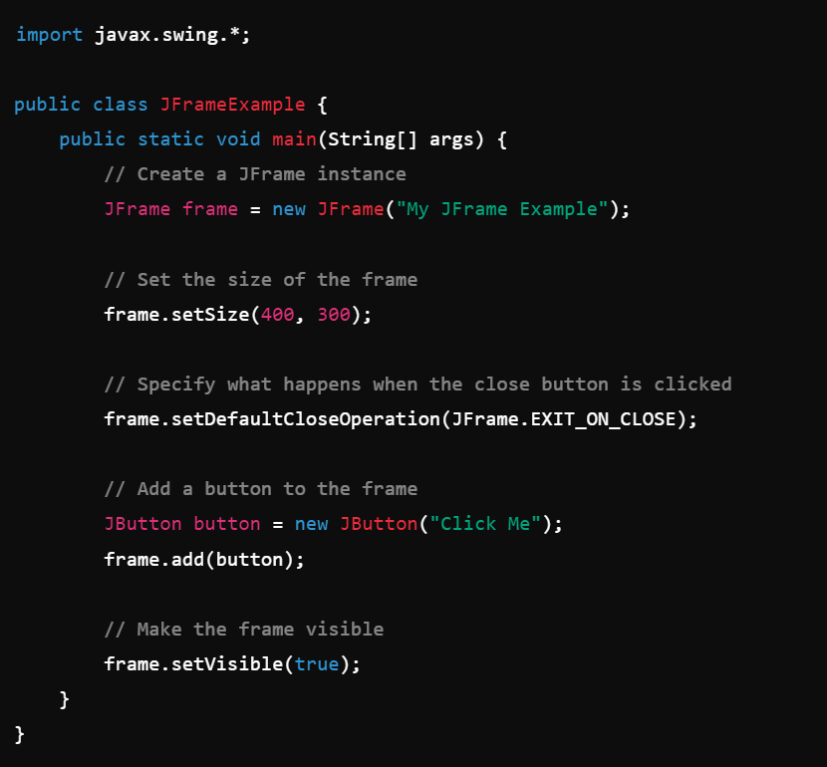
Example:

Slide 17
JApplet :
JApplet is a class in the Java Swing library that extends the Applet class and provides a framework for building applets with a Swing-based graphical user interface (GUI).
Applets are small Java programs that are typically embedded within a web page and run in a web browser. JApplet was designed to use the rich, lightweight components from Swing, as opposed to the heavyweight AWT components used in Applet.

Slide 18
JDialog:
JDialog is a part of the Java Swing library and is used to create dialog windows, which are smaller windows that appear on top of the main application window (JFrame).
Unlike JFrame, which represents a full-fledged window, JDialog is typically used for temporary, pop-up windows that require user interaction, such as alerts, confirmations, or input forms.
Jpanel:
JPanel is one of the most commonly used components in the Java Swing library. It is a lightweight container that can hold and organize a group of components, such as buttons, labels, text fields, or other panels. It serves as a flexible, invisible container to help structure the layout of GUI.

Slide 19
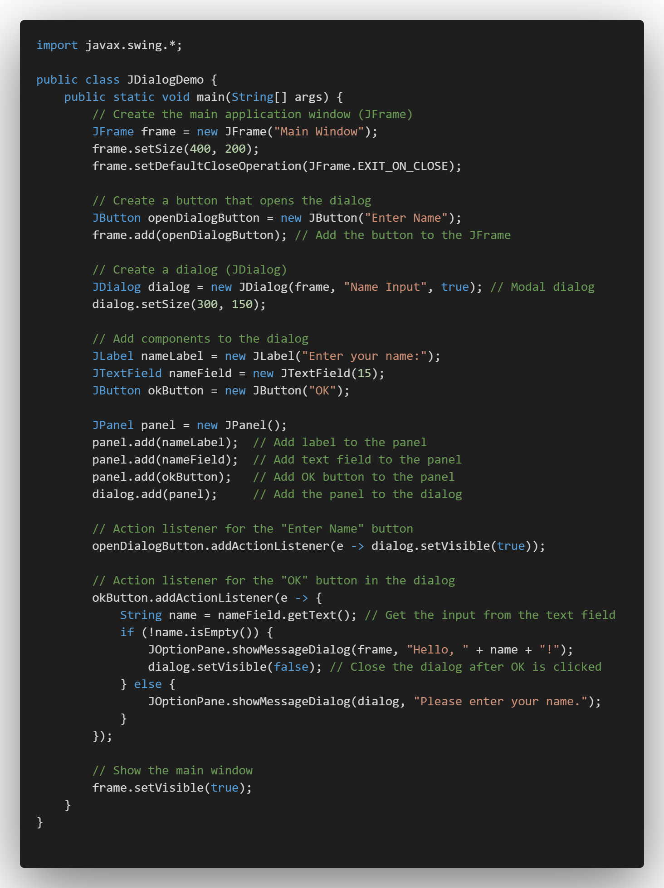
Example:
JDialog
Jpanel
Jlabel
JTextField
JButton

Slide 20
Layout management:
Layout Manager controls the positioning and sizing of components within a container. Different layout managers provide different ways to arrange components, making GUI design more flexible and dynamic.
Layout manager types:
Java Swing provides several layout managers that allow you to organize components in different ways within containers like JFrame, JPanel, and JDialog.
FlowLayout
BorderLayout
GridLayout

Slide 21
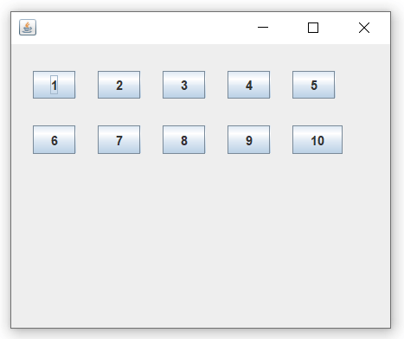
FlowLayout :
FlowLayout arranges components in a line (left to right) and wraps to the next line if there isn’t enough space. Components are aligned to the left, center, or right (default is centered).
Use Case: Common for toolbar-like layouts or for smaller components that don’t require precise.

Slide 22

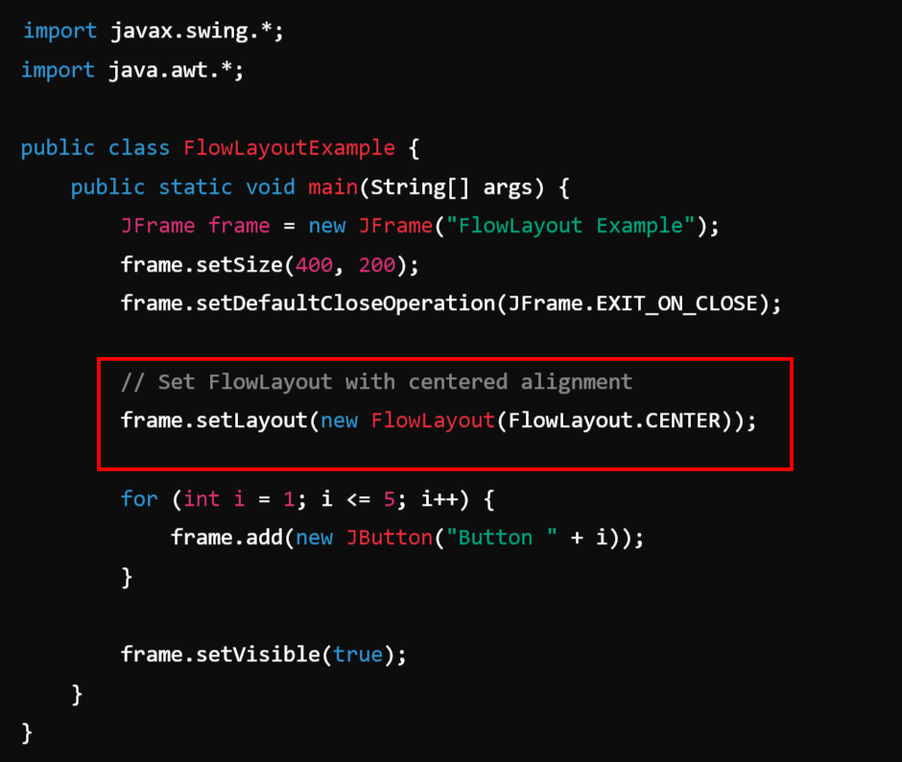
Example:

Slide 23
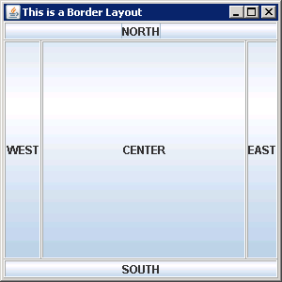
BorderLayout:
BorderLayout divides the container into five regions: NORTH, SOUTH, EAST, WEST, and CENTER. Each region can hold only one component. The CENTER region expands to fill any remaining space.
Use Case: Suitable for applications with a main central area and surrounding sections (like a header, footer, or sidebars).

Slide 24
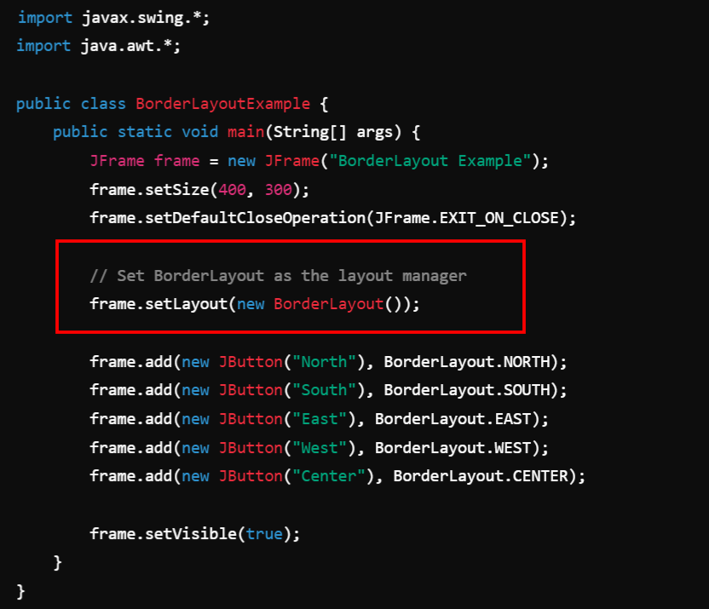
Example:

Slide 25
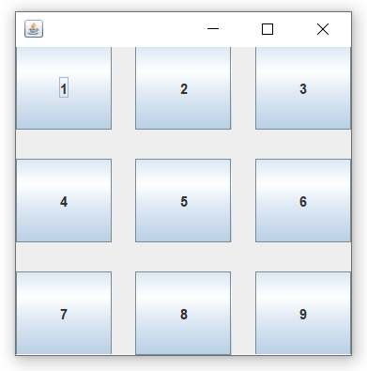
GridLayout:
GridLayout arranges components in a rectangular grid of rows and columns. Each cell in the grid is of equal size, and all components are resized to fit within their assigned cell.
Use Case: Useful for creating uniform, grid-like layouts, such as calculator buttons or a game board.

Slide 26
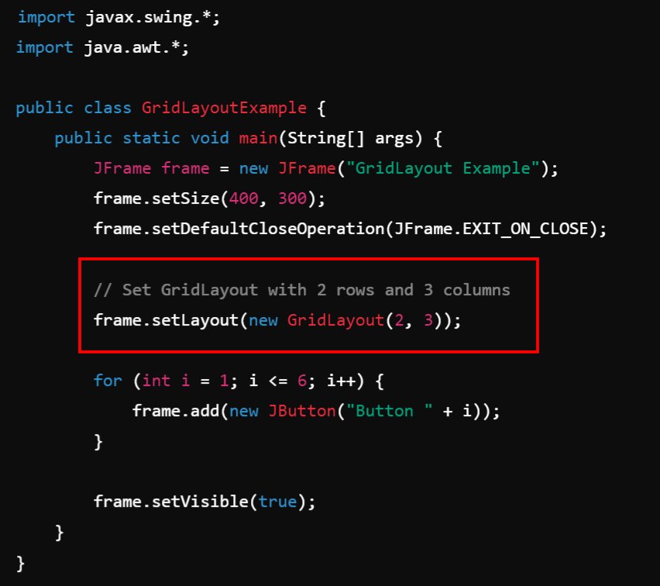
Example:

Slide 27
Applets

Slide 28
Applet:
An applet in Java is a small application that can run in a web browser or applet viewer. To create a Interactive or dynamic Web Page.
Applets were primarily designed to provide interactive features in web pages, but over time their usage has decreased, especially with the shift towards modern web technologies like HTML5, JavaScript, and CSS.

Slide 29
What is an Applet?
An applet is a subclass of java.applet.Applet or javax.swing.JApplet.
It is a Java program embedded into web pages and can be executed using a Java-enabled browser or an applet viewer tool.
Applets are different from standalone applications because they don't have a main() method. Instead, they rely on lifecycle methods for execution.
Types of Applets:
AWT Applet (java.applet.Applet): Uses Abstract Window Toolkit (AWT) components like Button, Label, TextField.
Swing Applet (javax.swing.JApplet): Uses Swing components like JButton, JLabel, JTextField. It offers more advanced GUI components compared to AWT.

Slide 30
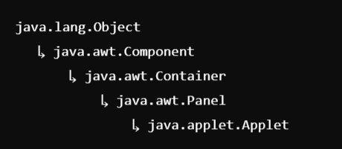
Inheritance hierarchy for applets:
In Java, applets are part of the class hierarchy that ultimately inherits from the base class java.lang.Object. Applets can be written using either the Abstract Window Toolkit (AWT) or Swing.
AWT Applet Inheritance Hierarchy:
AWT-based applets inherit from the java.applet.Applet class, which in turn inherits from other standard Java classes. Here is the detailed inheritance hierarchy:

Slide 31
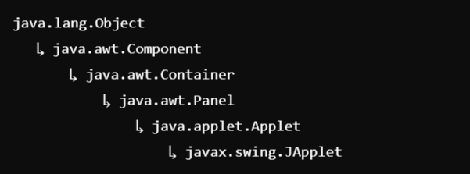
2. Swing Applet Inheritance Hierarchy:
Swing-based applets inherit from javax.swing.JApplet, which adds more advanced GUI capabilities by utilizing the Swing toolkit.
Hierarchy:

Slide 32
Differences between Applets and Applications:
Feature | Java Applet | Java Application
Definition | A small program that runs within a web browser or applet viewer. | A standalone program that runs directly on the JVM.
Execution Environment | Runs in a web browser or applet viewer (like appletviewer). | Runs in the Java Virtual Machine (JVM).
Main Method | No main() method; uses init(), start(), stop(), and destroy() methods. | Entry point is public static void main(String[] args).
Security Restrictions | Restricted by a security sandbox (can’t access local file system by default). | Has full access to the system resources (based on permissions).
User Interaction | Limited due to browser restrictions. | Full control over user interaction and system resources.
GUI Creation | Typically uses AWT (Abstract Window Toolkit) for user interface components. | Can use Swing, AWT, JavaFX, or other libraries for GUI creation.
Deployment | Embedded within a web page as an applet tag or called in an HTML page. | Run directly from a Java archive (JAR) or class file on the desktop or server.
Network Access | Limited to the server from which it was downloaded, unless explicitly signed. | No restrictions on network access (depends on application configuration).
Performance | Generally slower due to browser overhead and security checks. | Generally faster as it runs directly on the local JVM.
Modern Usage | Rarely used, as browsers no longer support applets due to security concerns. | Widely used in a variety of desktop and server applications.

Slide 33
Life Cycle of an Applet:
In Java, an applet is a special type of program embedded in the web page to generate dynamic content. Applet is a class in Java.
The applet life cycle can be defined as the process of how the object is created, started, stopped, and destroyed during the entire execution of its application. It basically has five core methods namely init(), start(), stop(), paint() and destroy().These methods are invoked by the browser to execute.
In Java, the life cycle of an applet consists of a sequence of methods that manage the different stages of an applet's existence. These methods ensure that the applet is initialized, starts running, stops when needed, and finally, is destroyed when no longer required.

Slide 34
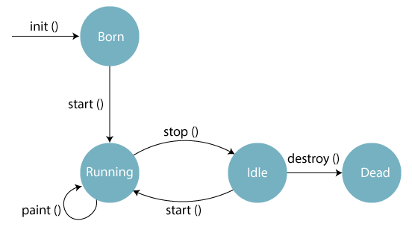

Slide 35
Initialization (init()):
Called when the applet is first loaded.
This method is used to initialize the applet, such as setting up the initial state, loading resources, or setting up the user interface.
Executed only once when the applet starts.
2. Starting (start()):
Called each time the applet becomes active (e.g., when the user visits or revisits the page containing the applet).
Typically used to start animations or any activity that needs to continue as long as the applet is active.
Can be called multiple times if the applet is paused and resumed.

Slide 36
3. Painting (paint(Graphics g) ):
Called whenever the applet’s display needs to be redrawn.
Used to render graphics and text on the applet’s display area.
Automatically called after init() and start(), and can be invoked by calling repaint().
4. Stopping (stop() ):
Called when the applet is no longer active, like when the user navigates away from the page.
Used to pause animations or other ongoing activities.
Can be called multiple times when the applet is paused and resumed.

Slide 37
5. Destruction (destroy()):
Called when the applet is being removed from memory (usually when the browser is closed).
Used to release resources and perform cleanup tasks.
Executed only once in the applet’s lifecycle, after stop().

Slide 38
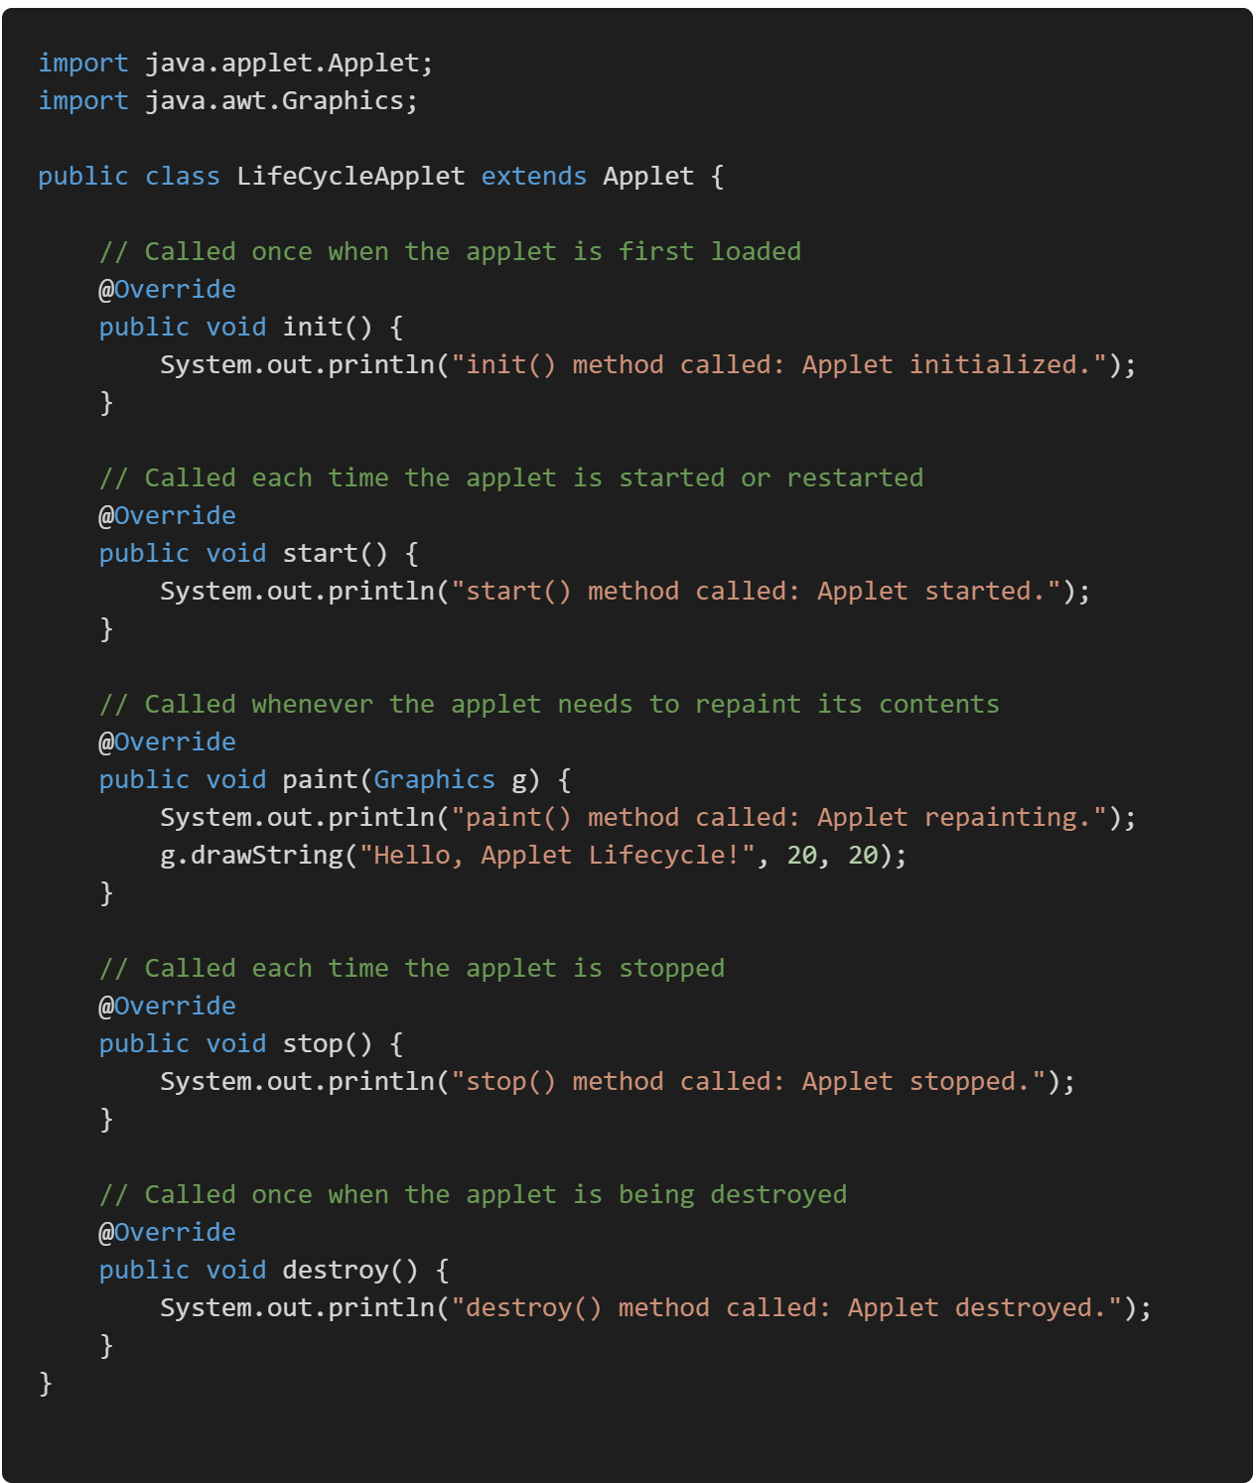
Example:
2 Ways to Run this Applet Program:
Using AppletViewer Tool (Without HTML File)
By Embedding the .class file in HTML.

Slide 39
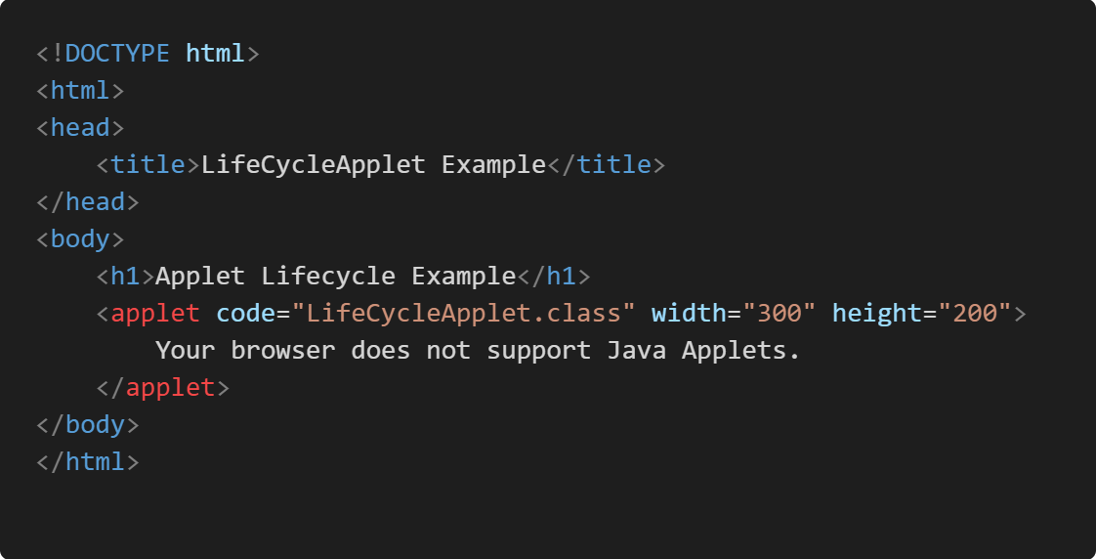
Embedding the .class file in HTML:

Slide 40
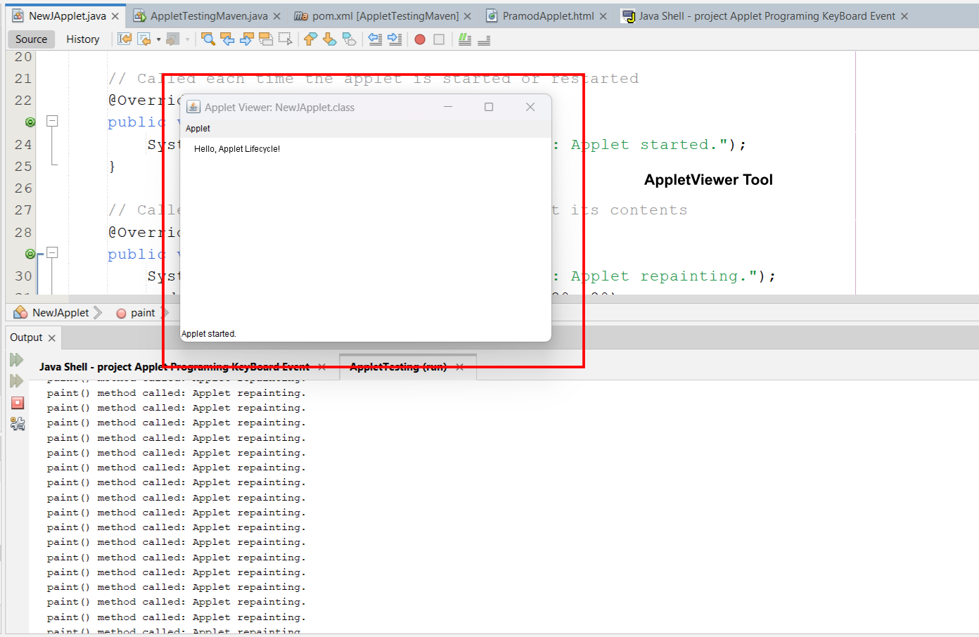
Output:

Slide 41
Passing Parameters to Applets:
In Java, an applet can receive parameters from an HTML file using the <param> tag.
These parameters are passed to the applet via the getParameter() method, which retrieves the value of a parameter specified in the HTML code.
The parameters can then be used inside the applet to control behavior, display messages, etc.

Slide 42
Steps to Pass the Parameter from HTML to Applet file:
HTML Code:
Parameters are passed from an HTML page where the applet is embedded. The <param> tag inside the <applet> tag specifies the parameter names and their values.
2. Applet Code:
In the applet's code, the getParameter(String name) method is used to retrieve the parameter values by specifying the parameter name.
3. Key Methods:
getParameter(String paramName): Used to get the value of a parameter passed to the applet.

Slide 43
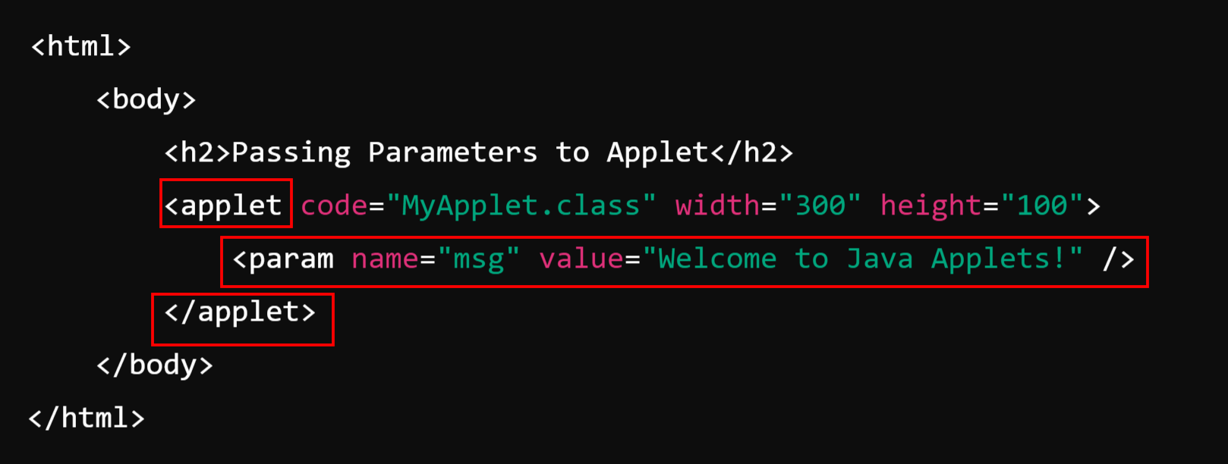
Example:
HTML File:

Slide 44
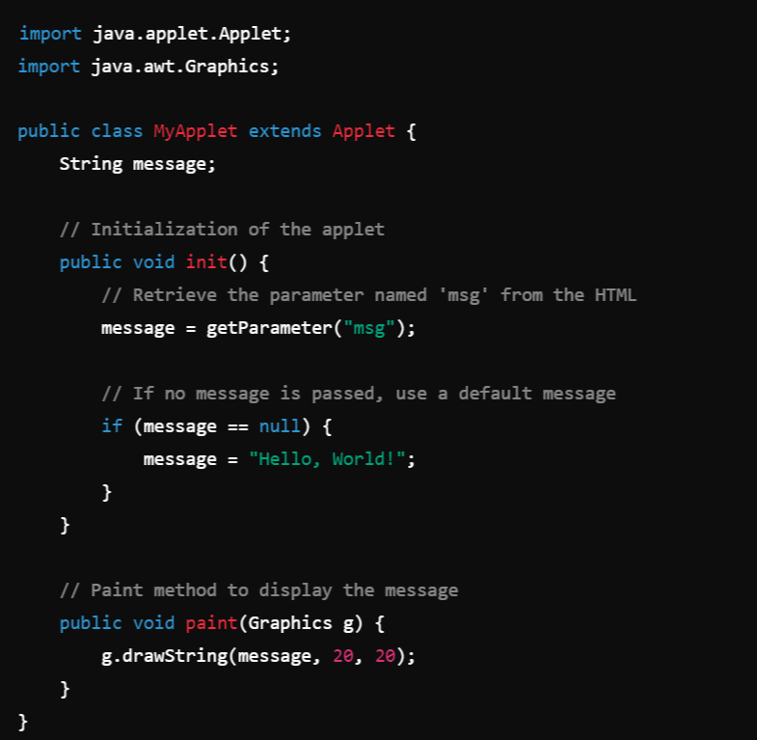
2. Applet Code: MyApplet.java

